Slide 1

Meet the teacher
2025 - 2026
Together with God, we will explore, discover and flourish

Slide 2

Year 5 and 6 team
Year 5
Mrs Bevan (Monday and Tuesday)
Miss Pelech (Wednesday, Thursday and Friday)
Year 6
Miss Rees
LSAs
Mrs Jones (ELSA / wellbeing)
PPA cover (usually Thursday morning)
Mrs Thorne (wellbeing) and Mr Smith (PE)
Together with God, we will explore, discover and flourish

Slide 3
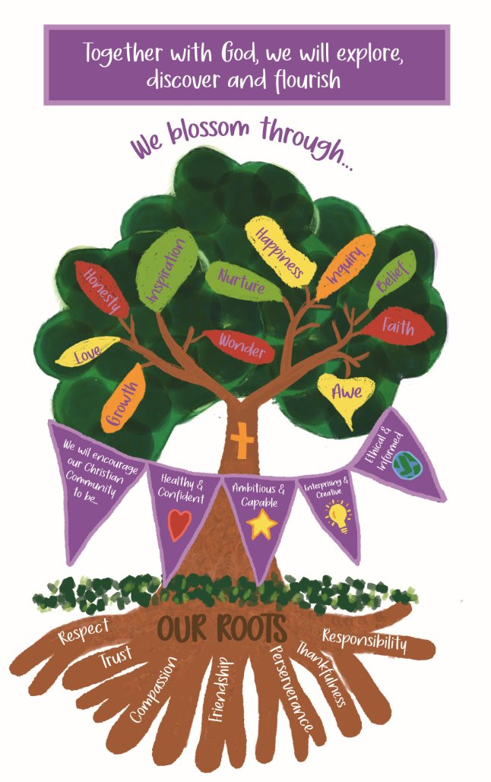
Our School Vision
Together with God, we will explore, discover and flourish
We aim to embed our vision through our day to day lives at Llansannor.
We are currently working on the Value of Responsibility, please encourage your children to take responsibility for their bedroom, some household chores and getting themselves ready for school.
Together with God, we will explore, discover and flourish
Together with God, we will explore, discover and flourish

Slide 4
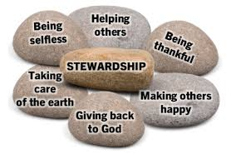


Topic plan for the year – year 5 & 6
 | Autumn | Spring | Summer
Topic | God's Gifts | Cymru am Byth | Faster, Higher, Stronger
Overarching theme | Stewardship v Dominionship | Mining in Wales | Aspirations, hopes and dreams
Main focus | Farming past and present Changes to our local area Farm to fork | Working in the mines Miners' strike Mining disasters | Inspirational people and achievements
Purpose / outcome | Create a thankfulness hunger cloth. | Black Gold museum to showcase the history of mining in Wales. | To design health and wellbeing activities for our families.
Together with God, we will explore, discover and flourish
Together with God, we will explore, discover and flourish

Slide 5
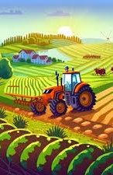
Autumn term topic
God's Gifts
Topic – God's Gifts
Jump in day – Garnic Farm and Ty Tanglwyst Dairy
Trips – Ty Tanglwyst, Sony
Celebrations – Holy Cross Christmas service December 9th
Sharing dates – Dewch i weld November 7th
Topic celebration – Create a 'hunger cloth'
Together with God, we will explore, discover and flourish

Slide 6

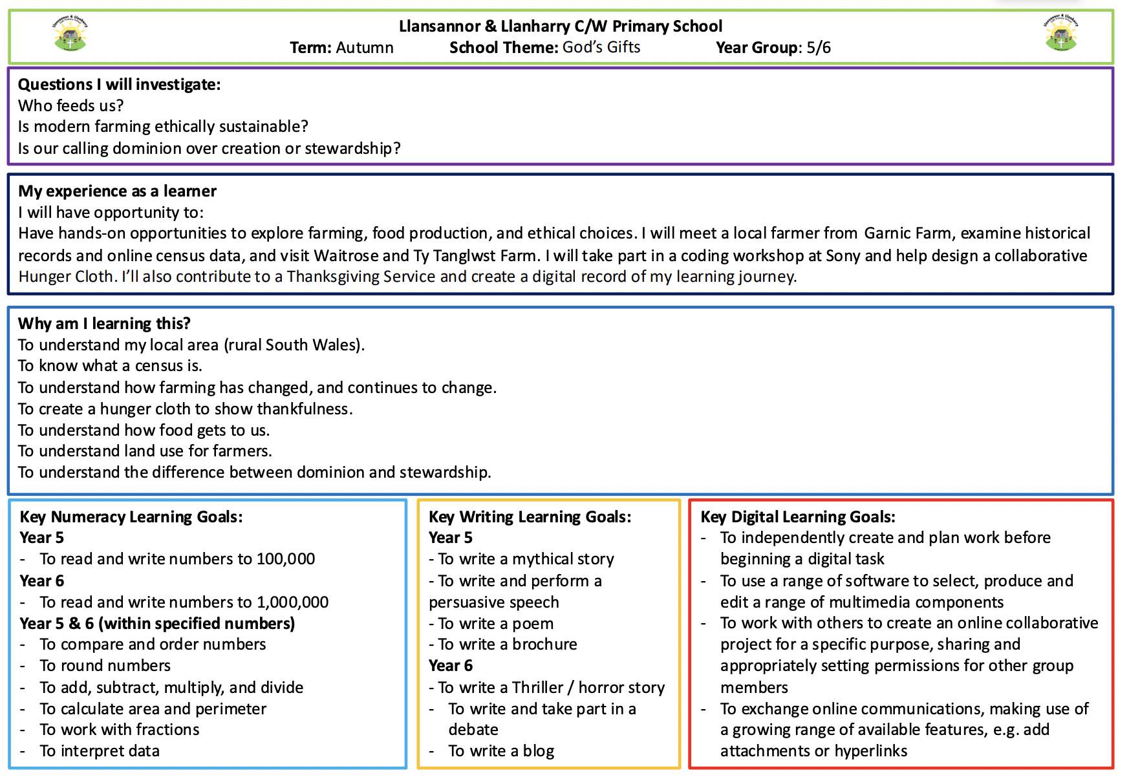
Overview of Autumn Term
God's Gifts – detailed overview
Link to website page - https://www.llansannorprimary.co.uk/
Together with God, we will explore, discover and flourish

Slide 7

A typical week in year 5 and 6…
 | Monday | Tuesday | Wednesday | Thursday | Friday
Soft start 8:55 – 9:15 | Spelling | TTRS | Wellbeing / outside | Reading | Reflection
Session 1 9:15 – 10:30 | Maths | Maths | Maths | PPA | Maths
Break 10:30-10:45
Session 2 10:45 – 11:45 | Literacy | Literacy | Literacy | PPA | Literacy
11:45 – 12:00 | Helpwr Heddiw | Helpwr Heddiw | Helpwr Heddiw | Helpwr Heddiw | Helpwr Heddiw
Lunch 12:00 – 1:00
Session 3 1:00 – 1:30 | RWInc / spelling / handwriting | Spelling / handwriting | Spelling / handwriting | Spelling / handwriting | Spelling / handwriting
Session 4 1:30 – 3:25 | Topic Talking circles | Topic Collective worship | RVE Collective worship | Maths Literacy Collective worship | Feedback Friday / Welsh games Celebration worship
Together with God, we will explore, discover and flourish

Slide 8
What do I need to bring to school?
Essential
PE kit bring on a Monday and take home on Friday. PE is set for a Thursday but can take place on other days.
Forest school clothes – you will be informed of the dates.
A small bag that fits in the cubby (y5) / on a peg (y6).
Water bottle and a healthy snack.
Reading book
Optional
Stationery - Everything your child needs in class but if they wish to bring a small pencil case, they can.
Together with God, we will explore, discover and flourish

Slide 9
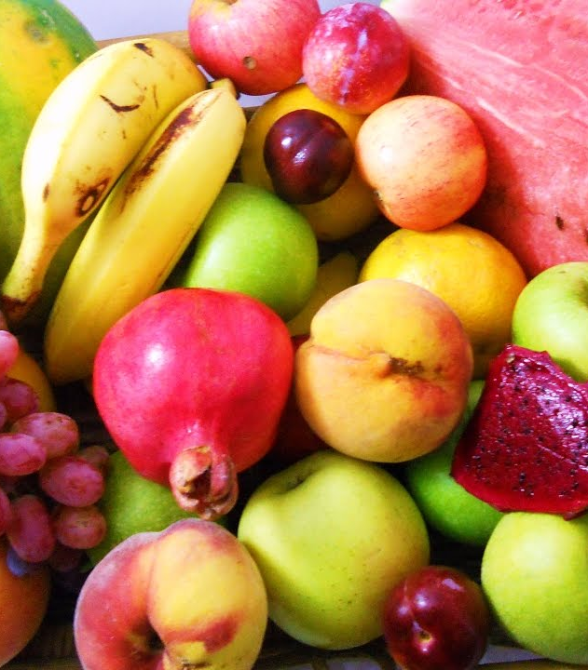

Daily snack
Please bring your own healthy snack to school – fruit or vegetables (no bars, dried fruit, crisps, biscuits, crackers, yoghurts, breads, etc)
Please bring plenty of water too! (label the water bottle please)
*if your child has brought a snack which is not a fruit of vegetable, they will be asked to put the snack away and will be offered a piece of fruit.
**No nuts due to nut allergies
Together with God, we will explore, discover and flourish

Slide 10
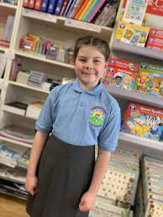
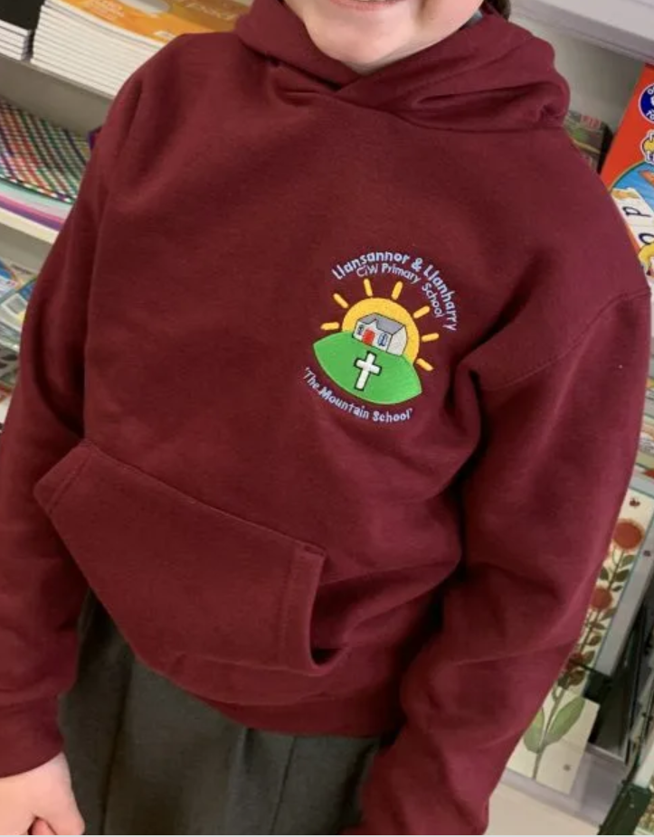
Uniform
Please label ALL items that your child brings to school.
Polo t-shirt, jumper / cardigan / hoodie, grey skirt / trousers / shorts etc, black shoes and coat.
PE kit – shorts / joggers, plain t-shirt (or white school logo), hoodie and trainers. Children will change into their kits in school.
Forest school –wellies, waterproof clothing (trousers and jacket / all-in-one)
Jewellery - small piercings (studs only) and watches only. No necklaces, rings, bracelets.
Together with God, we will explore, discover and flourish

Slide 11
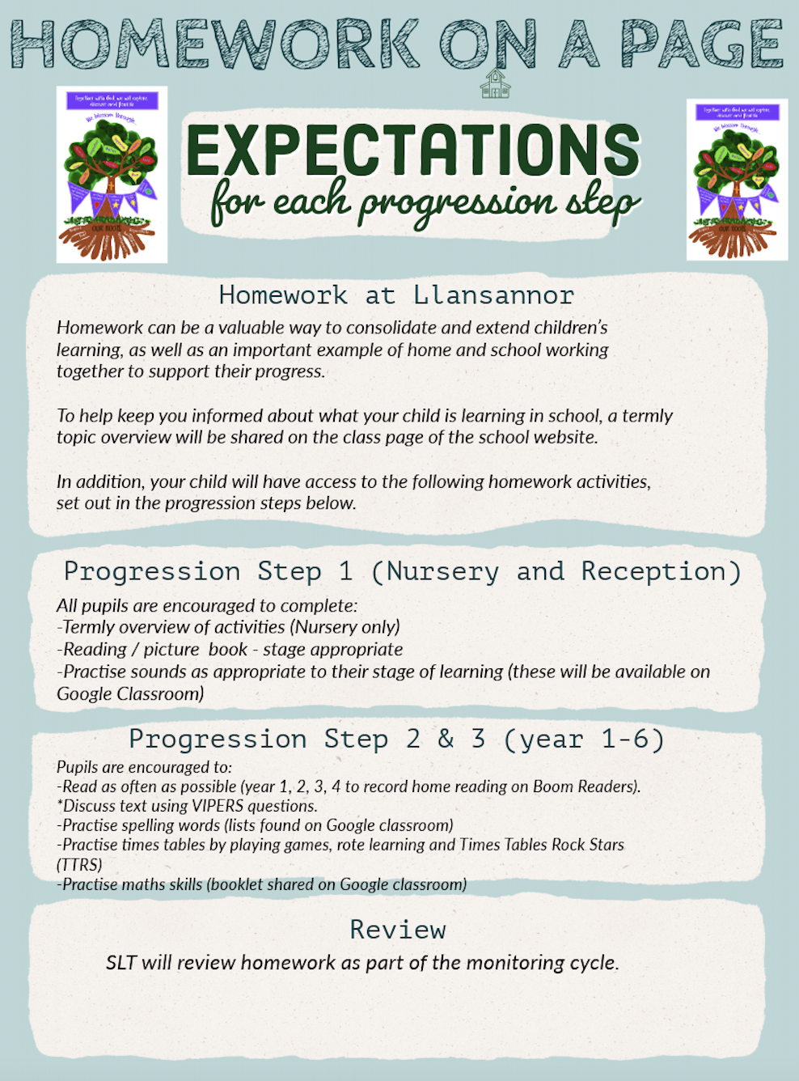
Expectations for home-school working
Together with God, we will explore, discover and flourish

Slide 12
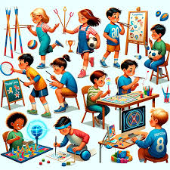

How do we assess your child and measure progress?
In house
Cold tasks and hot tasks will be used to ensure pupils are progressing over the space of a sequence of lessons. These are identified in the children's books with a blue (cold) and red (hot) dot.
Regular phonic / reading / maths / spelling assessments.
Staff hold termly pupil progress meetings with SLT to discuss progress of individual pupils – early identification is key. Support / resources are put in place to close the gap.
Staff meet regularly with ALNCo who can offer advice, strategies and techniques that can help your child make progress, where needed.
Interventions
As part of our universal provision pupils may be offered short term interventions such as ELSA, catch up reading / maths / social groups.
Interventions are used to reinforce skills learnt during the lesson.
Social / emotional interventions support children to ensure they are ready to learn. Wellbeing will always come first. Happy children learn best.
Cluster work
Half termly meetings with cluster colleagues for moderation, ensuring our pupils have equitable learning.
Together with God, we will explore, discover and flourish

Slide 13
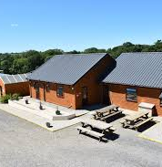
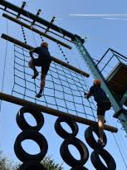
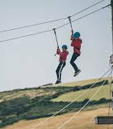
Year 5 and 6 residentials
Morfa Bay – September 22nd – 24th 2025
https://www.morfabay.com/
Llangrannog – March 11th – 13th 2026
https://www.urdd.cymru/en/residential-centres/llangrannog/
Kit lists and consent forms will be sent out prior to the trip.
Please make sure that all items are labelled for a residential, this helps with return packing.
Together with God, we will explore, discover and flourish

Slide 14

How we communicate progress with home?
Sharing sessions and parent meeting dates are set:
Autumn Term
Dewch i weld session (a chance to see your child's work in their classroom) Friday 7th November (pm)
During this session you will have a look at your child's learning journey. The class teacher(s) will provide you with 3 next step targets for your child, together with ways you can help at home
Spring Term
Parent meetings (date tbc)
Discussion of progress and ways you can help at home
Summer Term
Written report
Together with God, we will explore, discover and flourish

Slide 15

How do we share important dates / events / learning?
Please ensure you keep up to date with the school news using:
School App - this includes calendar dates, emails and notifications
Class Dojo – weekly snippets of learning that is taking place
Newsletter - half termly to celebrate learning
Website - overview of learning and links to home school websites such as TT rockstars, editable forms such as medical and holiday forms
Important events will be on the school calendar on the website and on the school app
Together with God, we will explore, discover and flourish

Slide 16



