Slide 1

School information
2025 - 2026
Together with God, we will explore, discover and flourish

Slide 2

Attendance
This year, the WG target is 96%. Please make every effort, where possible, to arrange holidays and appointments outside of school hours.
Together with God, we will explore, discover and flourish

Slide 3

What to do if your child is absent from school
Illness
If your child is ill and unable to attend school, please telephone and leave a message. You will need to do this for every day your child is unwell.
Appointment
Please inform the school if your child has an appointment during the school day. Please make every effort to keep regular check-ups after school / during the school holidays.
Holiday
Please complete a holiday form, available on the school website, and return to the school office or email to llansannorps@valeofglamorgan.gov.uk
Please note term time holiday will be unauthorised
Together with God, we will explore, discover and flourish

Slide 4

Who to contact
Class teacher
Always first point of contact (please call the school 01443 223545 or email at llansannorps@valeofglamorgan.gov.uk )
SLT / Deputy Head
If the class teacher feels addition input is required, he/she will discuss with a member of SLT (Miss Fisher/Mrs Miller) / deputy head (Mrs Bevan)
ALNCo
Class teacher will share concerns with the ALNCo (Mrs Miller). If you have concerns about addition learning needs, please discuss with the class teacher initially.
Headteacher
If the deputy head feels additional input is required, she will discuss with the Headteacher (Mrs Davies)
Note: please allow up to 48 hours for the class teacher to return a call / email
Together with God, we will explore, discover and flourish

Slide 5
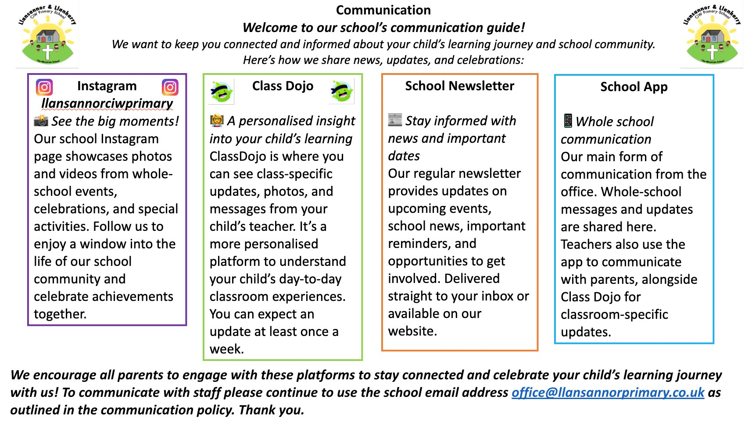
Keeping up to date with news and events
Together with God, we will explore, discover and flourish

Slide 6

Before and after school
Breakfast club
Our school run breakfast club starts at 8:15. Last entrance at 8:35am. If you wish your child to start breakfast club, please complete a form (available on the school website).
Clwb y Mynydd
Clwb y Mynydd is an after school club run by Mrs L. Jones and Mrs C. Smith. For all Clwb y Mynydd enquires please contact afterschoolclub244@gmail.com / 07903 141593
If there is an urgent change in your child's end of school arrangements, please remember to inform both school (on the school telephone) and Clwb y Mynydd.
Together with God, we will explore, discover and flourish

Slide 7
Complaints
Your views are very important to us and we want every member of our school community to be happy.
Please adhere to our school complaints policy when voicing any concerns.
We respectfully ask that you contact school first.
Do not post any grievances on social media – including WhatsApp groups.
Our complaints policy can be found on our school website:
https://primarysite-prod-sorted.s3.amazonaws.com/llansannor-cw-primary-school/UploadedDocument/75e80912-a160-4110-92b3-f964f75dbe72/complaints-policy-23.pdf
Together with God, we will explore, discover and flourish

Slide 8

Any questions?
Please feel free to contact us via the school office
office@llansannorprimary.co.uk
Together with God, we will explore, discover and flourish

