Slide 1

Meet the teacher
2025 - 2026
Together with God, we will explore, discover and flourish

Slide 2
Reception team
Miss O'Sullivan (class teacher) and Mrs Smith (LSA)
PPA cover (Wednesday afternoon)
Mr Smith (PE)
Together with God, we will explore, discover and flourish

Slide 3
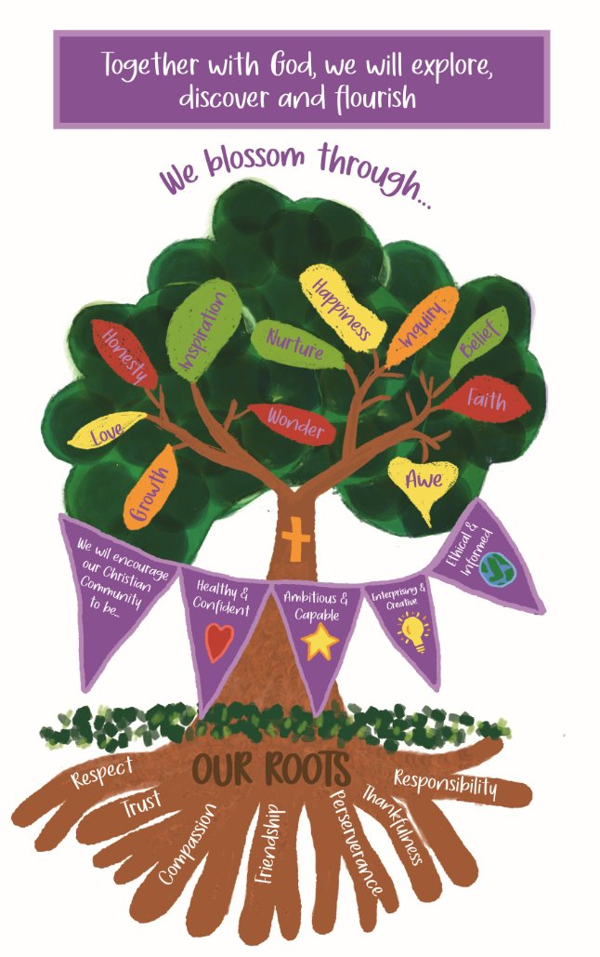
Our School Vision
Together with God, we will explore, discover and flourish
We aim to embed our vision through our day to day lives at Llansannor.
We are currently working on the Value of Responsibility, please encourage your children to take responsibility for their toys, help with some simple household chores and begin to get themselves ready for school.
Together with God, we will explore, discover and flourish
Together with God, we will explore, discover and flourish

Slide 4
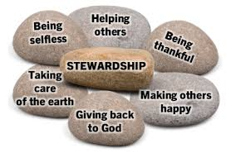


Topic plan for the year
 | Autumn | Spring | Summer
Topic | God's Gifts | Cymru am Byth | Faster, Higher, Stronger
Overarching theme | How we flourish? | Fairy Tales | Keeping myself safe and healthy
Main focus | How do I flourish?How do farmers help us flourish? How does kindness help us flourish? | Story telling Role play | What happens to me when I exercise? Why do we brush our teeth? How do I keep clean?
Purpose / outcome | Take part in Harvest thanksgiving | Make a short video presenting a story | Posters to show how to keep healthy
Together with God, we will explore, discover and flourish
Together with God, we will explore, discover and flourish

Slide 5
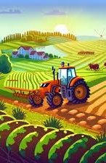
Autumn term topic
God's Gifts
Topic – God's Gifts
Jump in day – Garnic Farm (10th Sept) and Ty Tanglwyst Dairy (October 7th)
Trips – Ty Tanglwyst
Celebrations – Christmas concert December 11th and 12th (am)
Sharing dates – Dewch i weld November 3rd
Topic celebration – Take part in a Harvest festival
Together with God, we will explore, discover and flourish

Slide 6

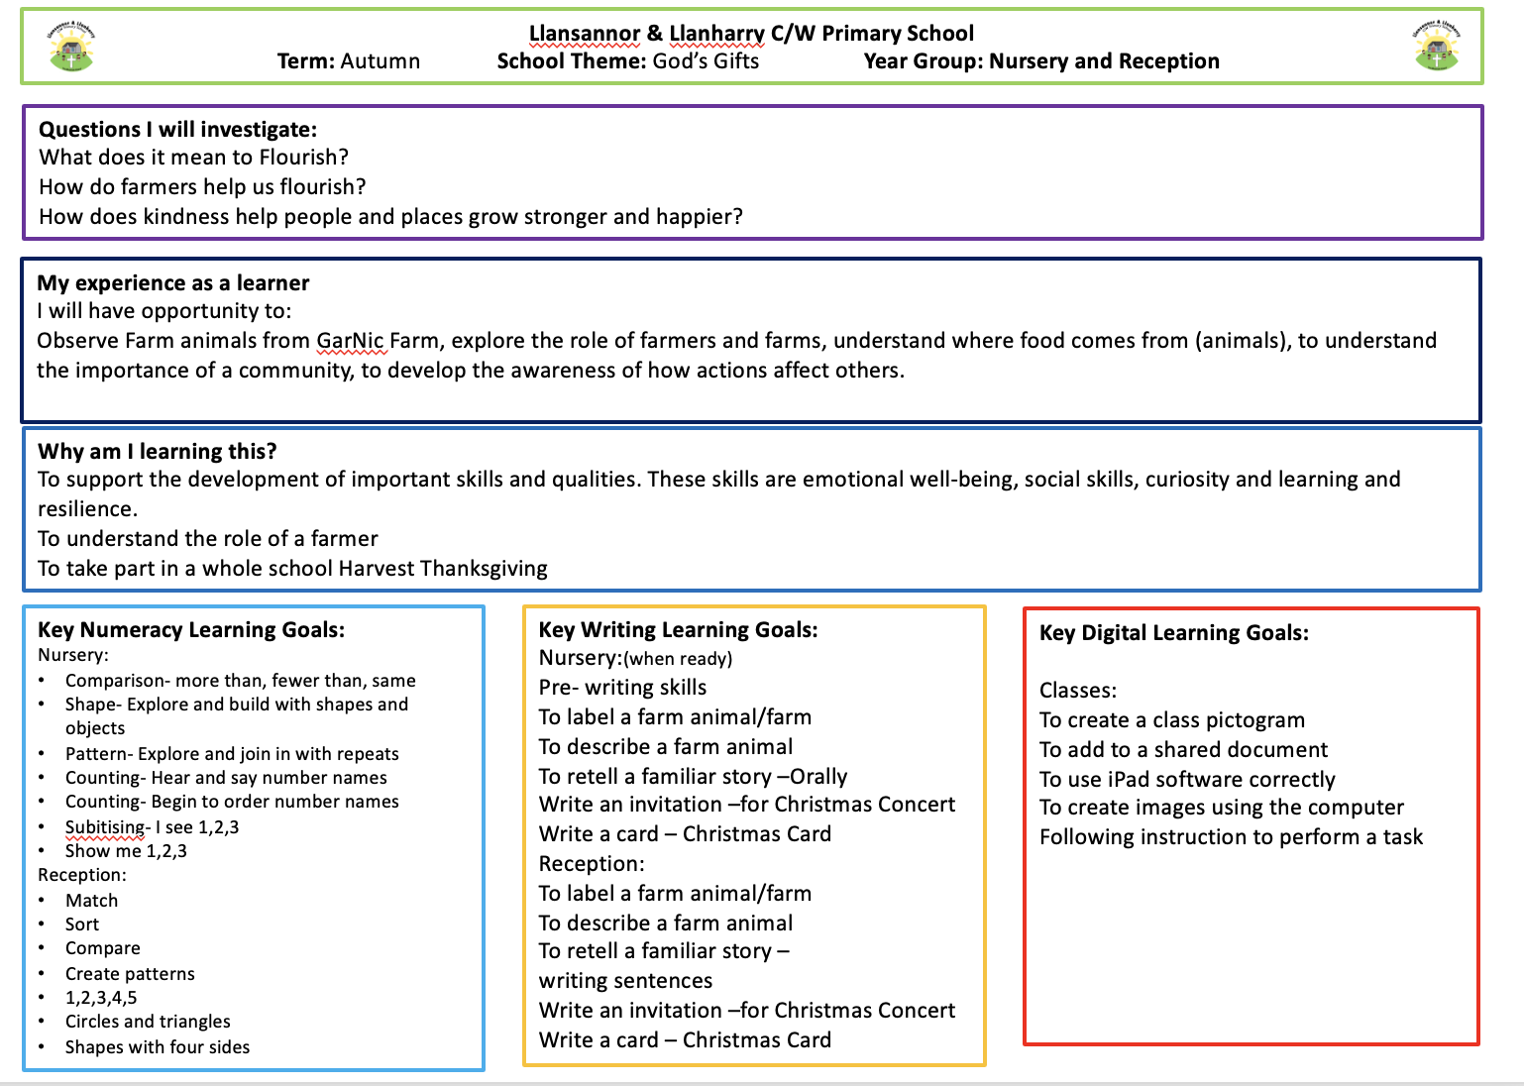
God's Gifts – detailed overview
Link to website page - https://www.llansannorprimary.co.uk/
Together with God, we will explore, discover and flourish

Slide 7

A typical week in Reception…
 | Monday | Tuesday | Wednesday | Thursday | Friday
Soft start 8:55 – 9:15 | Fine motor | Digital literacy | Name writing | Reading | Wellbeing/outside
Morning session 9:00 – 11:45 | Maths | Maths | Maths | Maths | Forest School
 | Literacy | Literacy | Literacy | Literacy | Forest School
 | Helpwr Heddiw | Helpwr Heddiw | Helpwr Heddiw | Helpwr Heddiw | Helpwr Heddiw
Lunch 11:45 – 1:00
Afternoon session 1:00 – 3:20 | Topic | Topic | PE | Topic | Skills
 | Topic | Topic | PE | Topic | Skills
Together with God, we will explore, discover and flourish

Slide 8
What do I need to bring to school?
PE kit please bring into school on a Wednesday. PE is set for a Wednesday.
Forest school clothes – every Friday, these will come home.
Water bottle and one healthy snack.
Reading book
Together with God, we will explore, discover and flourish

Slide 9
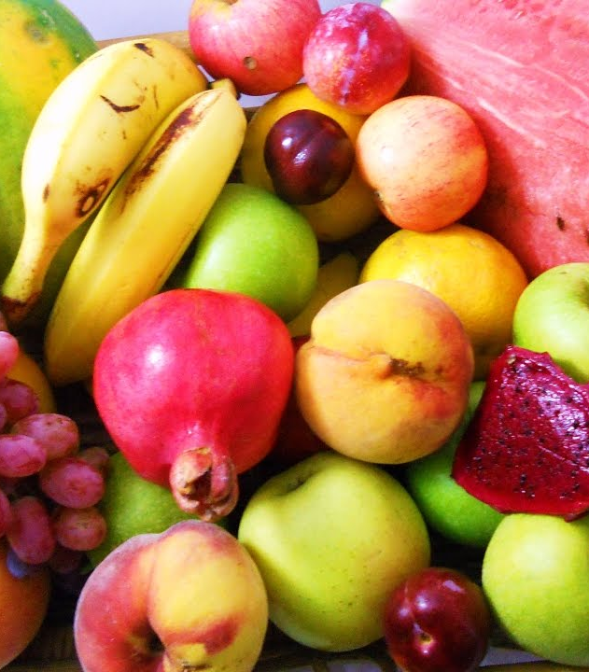

Daily snack
Please bring your own healthy snack to school – fruit or vegetables (no bars, dried fruit, crisps, biscuits, crackers, yoghurts, breads, etc)
Please bring plenty of water too! (label the water bottle please)
*if your child has brought a snack which is not a fruit of vegetable, they will be asked to put the snack away and will be offered a piece of fruit.
**No nuts due to nut allergies
Together with God, we will explore, discover and flourish

Slide 10
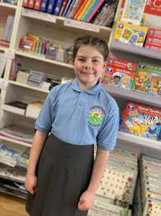
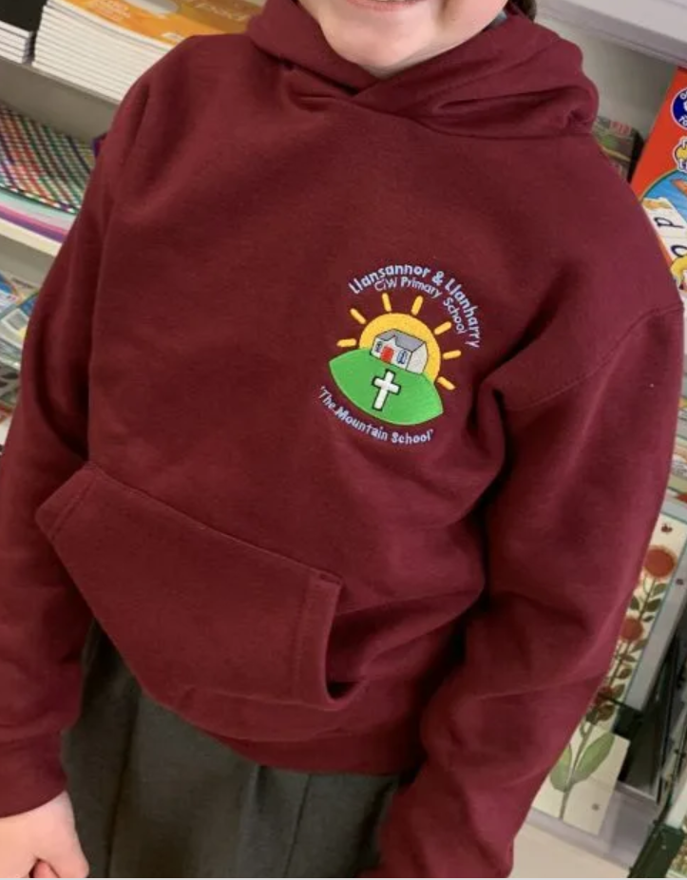
Uniform
Please label ALL items that your child brings to school.
Polo t-shirt, jumper / cardigan / hoodie, grey skirt / trousers / shorts etc, black shoes and coat.
PE kit – shorts / joggers, plain t-shirt (or white school logo), hoodie and trainers. Children will change into their kits in school.
Forest school –wellies, waterproof clothing (trousers and jacket / all-in-one)
Jewellery - small piercings (studs only) and watches only. No necklaces, rings, bracelets.
Together with God, we will explore, discover and flourish

Slide 11
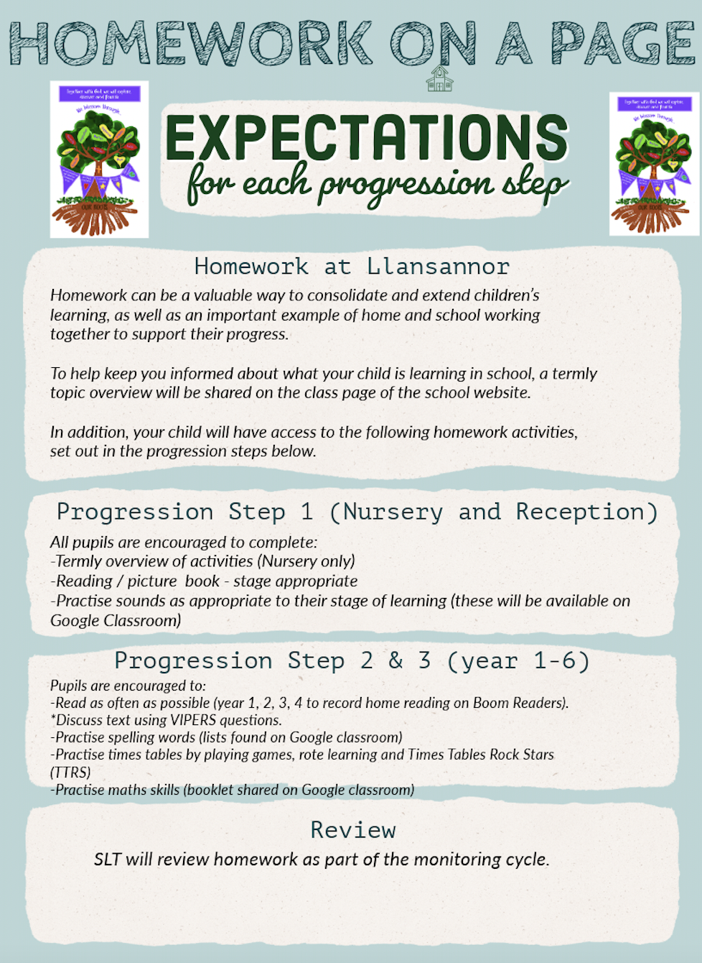
Expectations for home-school working
Together with God, we will explore, discover and flourish

Slide 12
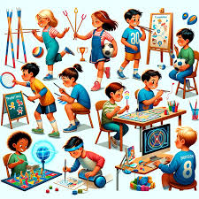

How do we assess your child and measure progress?
In house
Cold tasks and hot tasks will be used to ensure pupils are progressing over the space of a sequence of lessons. These are identified in the children's books with a blue (cold) and red (hot) dot.
Regular phonic assessments.
Staff hold termly pupil progress meetings with SLT to discuss progress of individual pupils – early identification is key. Support / resources are put in place to close the gap
Staff meet regularly with ALNCo who can offer advice, strategies and techniques that can help your child make progress, where needed
Interventions
As part of our universal provision pupils may be offered short term interventions such as ELSA, catch up reading / maths / social group
Interventions are used to reinforce skills learnt during the lesson
Social / emotional interventions support children to ensure they are ready to learn. Wellbeing will always come first. Happy children learn best.
Cluster work
Half termly meetings with cluster colleagues for moderation, ensuring our pupils have equitable learning
Together with God, we will explore, discover and flourish

Slide 13

How we communicate progress with home?
Sharing sessions and parent meeting dates are set:
Autumn Term
Dewch i weld session (a chance to see your child's work in their classroom) November 3rd
During these sessions you will have a look at your child's learning journey. The class teacher(s) will provide you with 3 next step targets for your child, together with ways you can help at home
Spring Term
Parent meetings (date tbc)
Discussion of progress and ways you can help at home
Summer Term
Written report
Together with God, we will explore, discover and flourish

Slide 14

How do we share important dates / events / learning?
Please ensure you keep up to date with the school news using:
School App - this includes calendar dates, emails and notifications
Class Dojo – weekly snippets of learning that is taking place (chat function will not be monitored)
Newsletter - half termly to celebrate learning
Website - overview of learning and links to home school websites such as TT rockstars, editable forms such as medical and holiday forms
Important events will be on the school calendar on the website and on the school app
Together with God, we will explore, discover and flourish

Slide 15


