Slide 1

Meet the teacher
2025 - 2026
Together with God, we will explore, discover and flourish

Slide 2

Year 1 and 2 team
Year 1
Mrs Petty (Monday, Tuesday, Wednesday), Miss Poole (Thursday, Friday)
Year 2
Miss Conlon
LSAs
Mrs Chandler & Mrs C Hurley am (year 1), Miss R Hurley (year 2)
PPA cover (usually Wednesday morning)
Mrs Thorne (wellbeing) and Mr Smith (PE)
Together with God, we will explore, discover and flourish

Slide 3
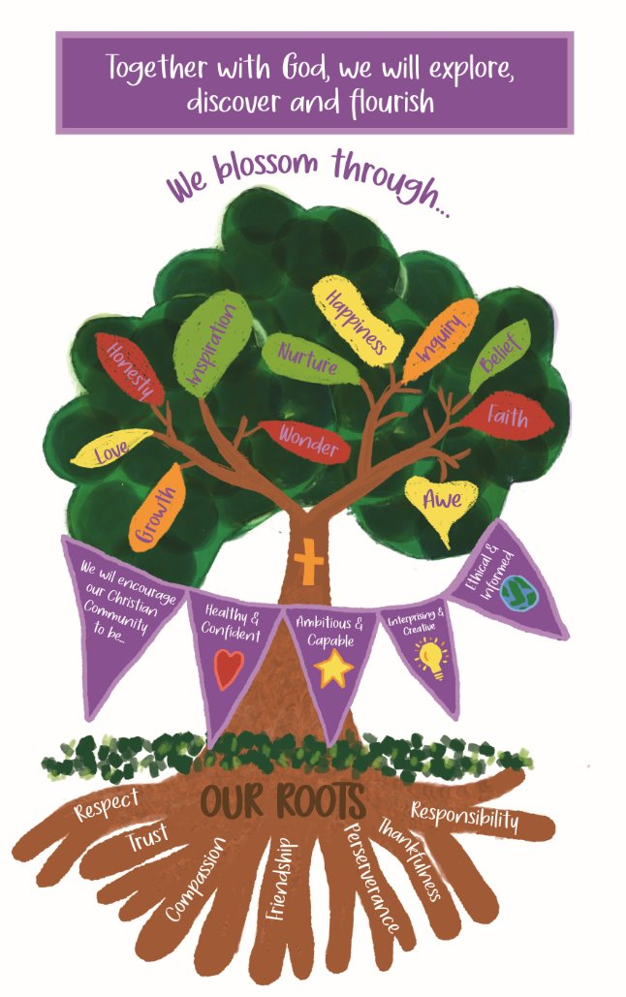
Our School Vision
Together with God, we will explore, discover and flourish
We aim to embed our vision through our day to day lives at Llansannor.
We are currently working on the Value of Responsibility, please encourage your children to take responsibility for their toys, some simple household chores and getting themselves ready for school.
Together with God, we will explore, discover and flourish
Together with God, we will explore, discover and flourish

Slide 4
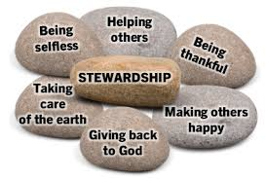


Topic plan for the year
 | Autumn | Spring | Summer
Topic | God's Gifts | Cymru am Byth | Faster, Higher, Stronger
Overarching theme | Thankfulness | Castles | Staying healthy
Main focus | What does it mean to be thankful? What am thankful for? How can I show that I am thankful? | Castles in Wales Features of castles | Looking after my teeth Exercising to keep me healthy
Purpose / outcome | Soundscape to show we are thankful for the farmers | Castle museum to showcase features | How to keep your teeth healthy – posters and video
Together with God, we will explore, discover and flourish
Together with God, we will explore, discover and flourish

Slide 5
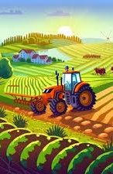
Autumn term topic
God's Gifts
Topic – God's Gifts
Jump in day – Garnic Farm and Ty Tanglwyst Dairy
Trips – Ty Tanglwyst
Celebrations – Christmas concert December 10th
Sharing dates – Dewich i weld November 4th
Topic celebration – Create a soundscape to perform in the Harvest festival
Together with God, we will explore, discover and flourish

Slide 6

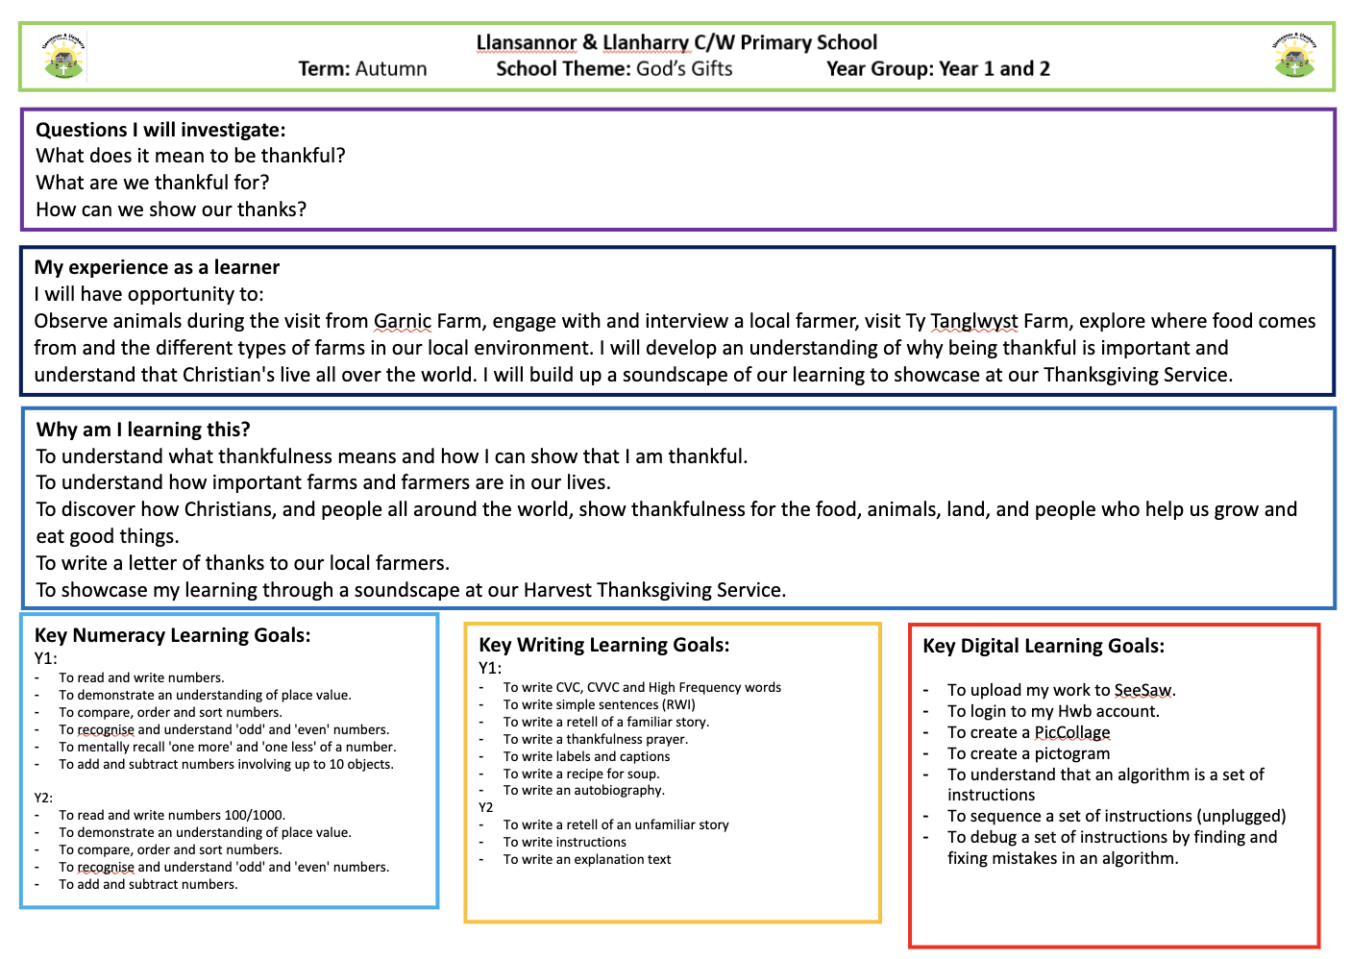
God's Gifts – detailed overview
Link to website page - https://www.llansannorprimary.co.uk/
Together with God, we will explore, discover and flourish

Slide 7

A typical week in year 1 and 2…
 | Monday | Tuesday | Wednesday | Thursday | Friday
Soft start 8:55 – 9:15 | 1:1 Reading, Maths, Fine motor, ICT, literacy and reflection
Session 1 9:15 – 10:30 | Maths | Maths | PPA - PE | Maths | PPA – well-being
Break 10:30-10:45
Session 2 10:45 – 12:00 | Literacy / RWI | Literacy / RWI | Literacy / RWI | Literacy / RWI | Maths
11:45 – 12:00 | Helpwr Heddiw | Helpwr Heddiw | Helpwr Heddiw | Helpwr Heddiw | Helpwr Heddiw
Lunch 12:00 – 1:00
Session 3 1:00 – 1:30 | RWInc / spelling / handwriting | RWInc / spelling / handwriting | RWInc / spelling / handwriting | RWInc / spelling / handwriting | RWInc / spelling / handwriting
Session 4 1:30 – 3:25 | Topic Talking circles | Topic Collective worship | Topic Collective worship | RVE Collective worship | Feedback Friday / Welsh games Celebration
Together with God, we will explore, discover and flourish

Slide 8
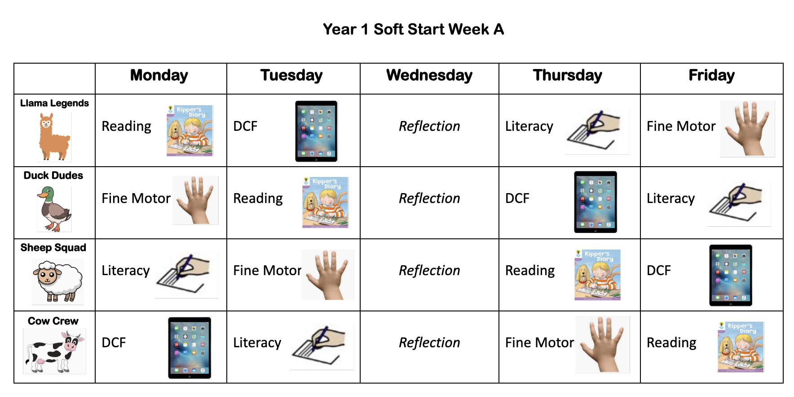

Slide 9
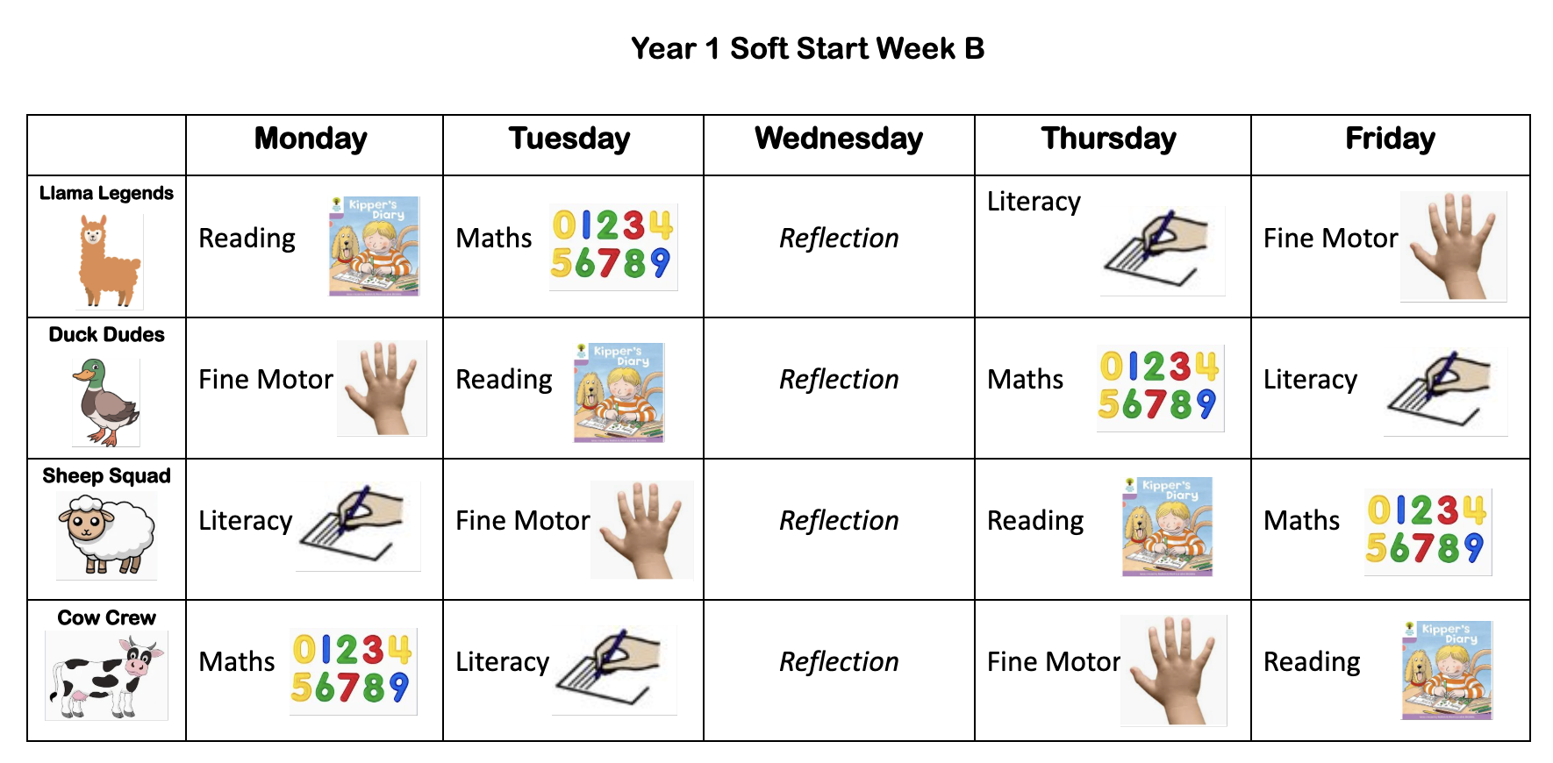

Slide 10
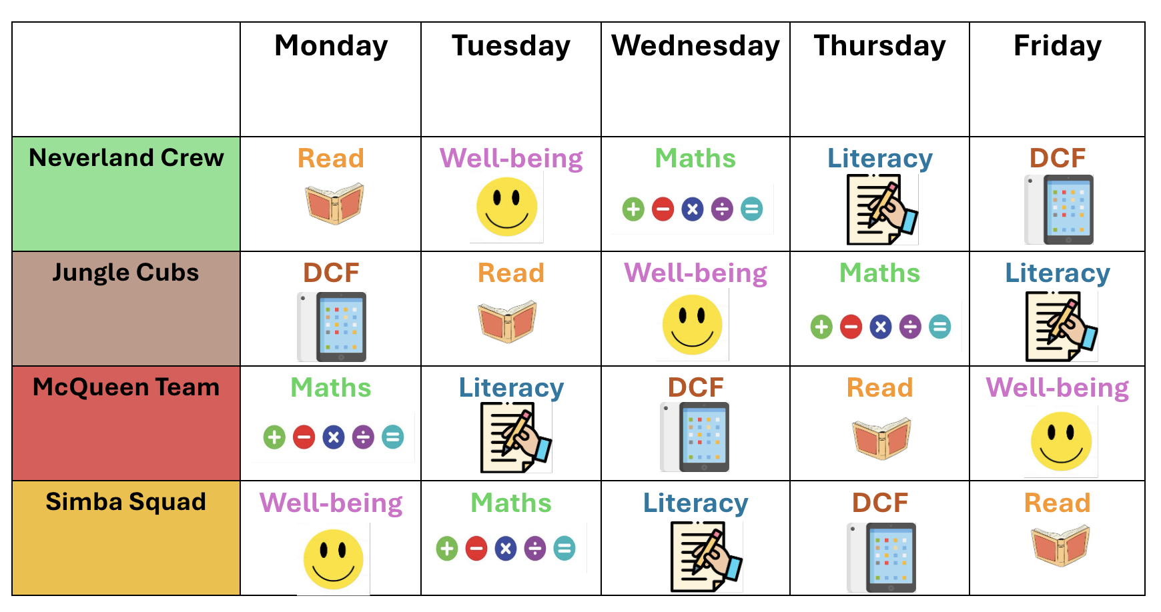
Year 2 Soft Start Timetable

Slide 11
What do I need to bring to school?
Please bring PE kit on a Monday and take home on Friday. PE is set for a Wednesday.
Forest school clothes – you will be informed of the dates.
A small bag that fits in the cubby.
Water bottle and a healthy snack.
Reading book.
Together with God, we will explore, discover and flourish

Slide 12
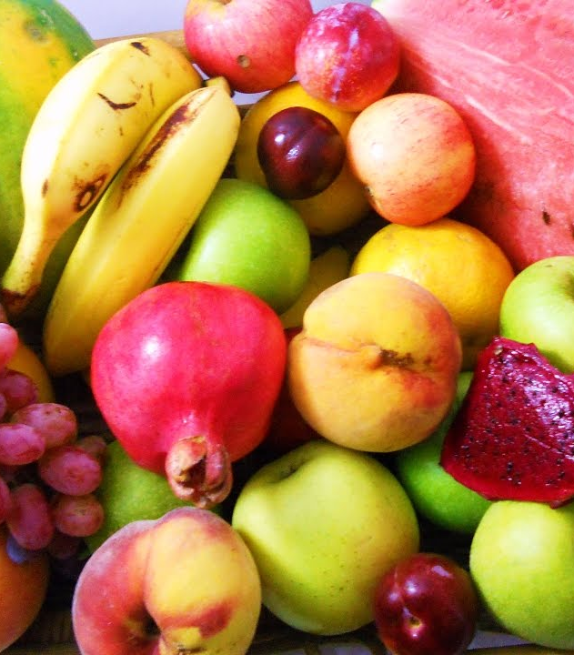

Daily snack
Please bring your own healthy snack to school – fruit or vegetables (no bars, dried fruit, crisps, biscuits, crackers, yoghurts, breads, etc)
Please bring plenty of water too! (label the water bottle please)
*if your child has brought a snack which is not a fruit of vegetable, they will be asked to put the snack away and will be offered a piece of fruit.
**No nuts due to nut allergies
Together with God, we will explore, discover and flourish

Slide 13
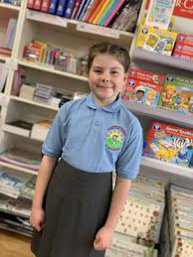
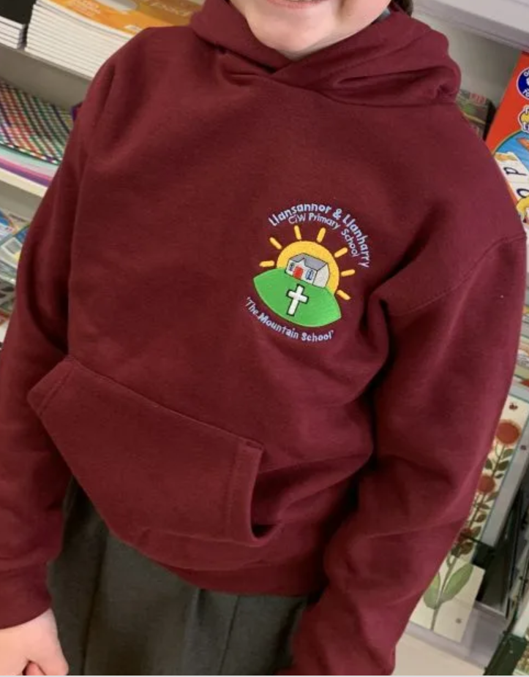
Uniform
Please label ALL items that your child brings to school.
Polo t-shirt, jumper / cardigan / hoodie, grey skirt / trousers / shorts etc, black shoes and coat.
PE kit – shorts / joggers, plain t-shirt (or white school logo), hoodie and trainers. Children will change into their kits in school.
Forest school –wellies, waterproof clothing (trousers and jacket / all-in-one)
Jewellery - small piercings (studs only) and watches only. No necklaces, rings, bracelets.
Together with God, we will explore, discover and flourish

Slide 14
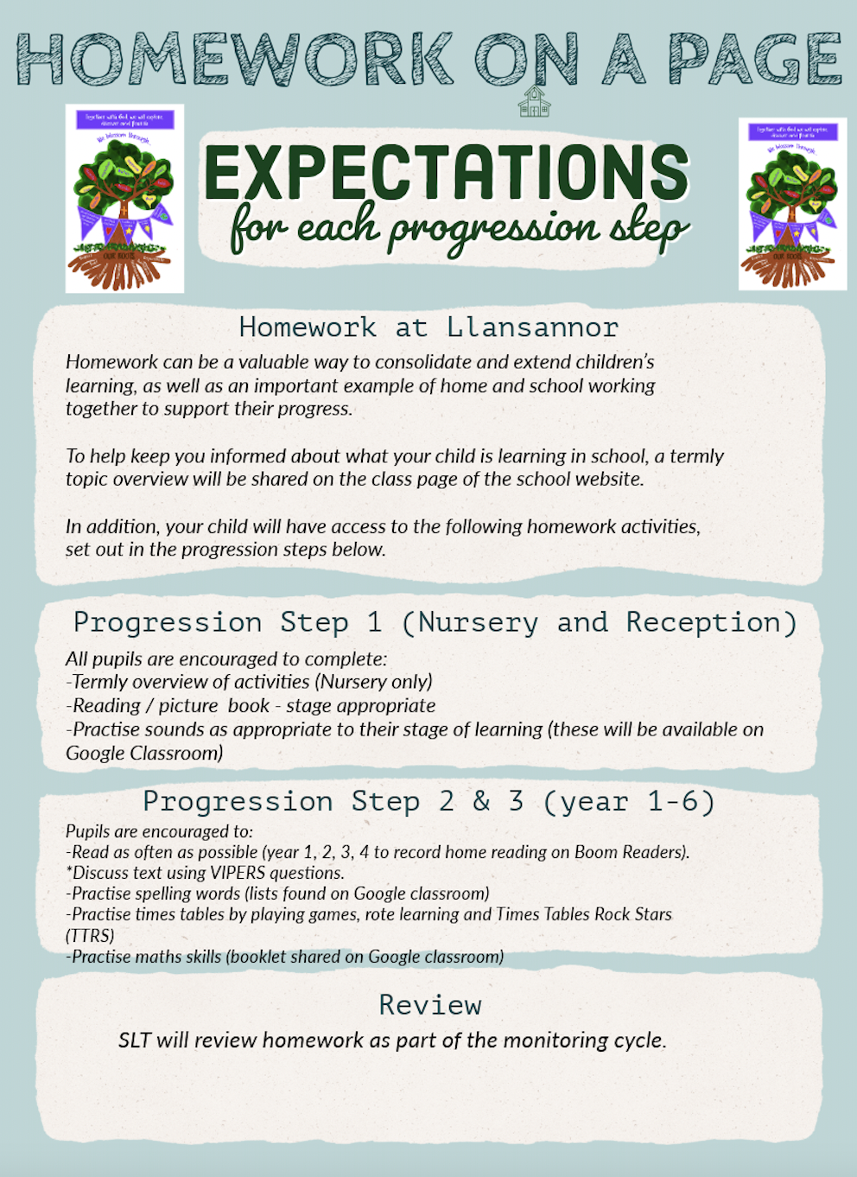
Expectations for home-school working
Together with God, we will explore, discover and flourish

Slide 15
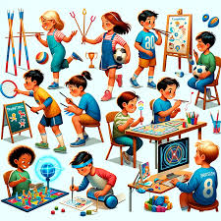

How do we assess your child and measure progress?
In house
Cold tasks and hot tasks will be used to ensure pupils are progressing over the space of a sequence of lessons. These are identified in the children's books with a blue (cold) and red (hot) dot.
Regular phonic / reading / maths / spelling assessments
Staff hold termly pupil progress meetings with SLT to discuss progress of individual pupils – early identification is key. Support / resources are put in place to close the gap
Staff meet regularly with ALNCo who can offer advice, strategies and techniques that can help your child make progress, where needed
Interventions
As part of our universal provision pupils may be offered short term interventions such as ELSA, catch up reading / maths / social group
Interventions are used to reinforce skills learnt during the lesson
Social / emotional interventions support children to ensure they are ready to learn. Wellbeing will always come first. Happy children learn best.
Cluster work
Half termly meetings with cluster colleagues for moderation, ensuring our pupils have equitable learning
Together with God, we will explore, discover and flourish

Slide 16

How we communicate progress with home?
Sharing sessions and parent meeting dates are set:
Autumn Term
Dewch i weld session (a chance to see your child's work in their classroom) Tuesday 4th November (pm)
During these sessions you will have a look at your child's learning journey. The class teacher(s) will provide you with 3 next step targets for your child, together with ways you can help at home
Spring Term
Parent meetings (date tbc)
Discussion of progress and ways you can help at home
Summer Term
Written report
Together with God, we will explore, discover and flourish

Slide 17

How do we share important dates / events / learning?
Please ensure you keep up to date with the school news using:
School App - this includes calendar dates, emails and notifications
Class Dojo – weekly snippets of learning that is taking place
Newsletter - half termly to celebrate learning
Website - overview of learning and links to home school websites such as TT rockstars, editable forms such as medical and holiday forms
Important events will be on the school calendar on the website and on the school app
Together with God, we will explore, discover and flourish

Slide 18


